Slide 1
Introduction to Complexity Theory

Slide 2
Tractable Problems vs. Intractable Problems
An algorithm for a given problem is said to be a polynomial time algorithm if its worst case complexity belongs to O(n^{k}) for a fixed integer k and an input size of n.
The set of all problems that can be solved in polynomial amount of time are called Tractable Problems. These problems can run in a reasonable amount of time for even very large amounts of input data.
The set of all problems that cannot be solved in polynomial amount of time are called Intractable Problems. It is of type O(k^{n}). Intractable problems require huge amounts of time for even modest input sizes.

Slide 3
1 | 1 | 1 | 1 | 1
log n | 3.3 | 4.3 | 4.9 | 5.3
n | 10 | 20 | 30 | 40
nlog n | 33 | 86 | 147 | 212
_{n}2 _{n}3
₂n
100 | 400 | 900 | 1600
1000 | 8000 | 27000 | 64000
1024 | 1 million | 1.1 billion | 1.1 trillion

Slide 4
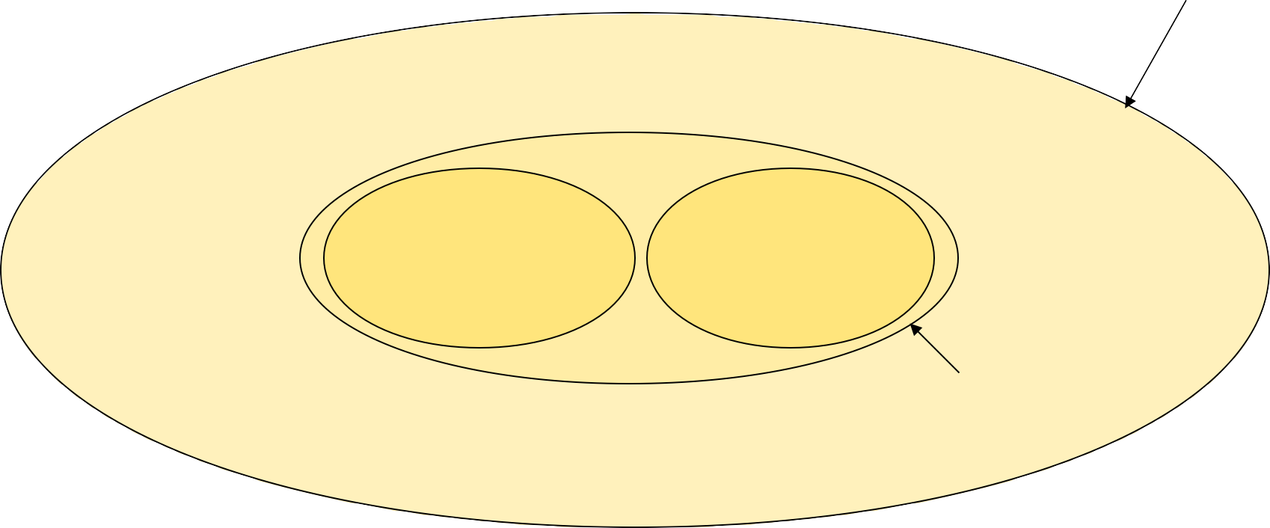
All Problems
Tractable solutions
Intractable solutions
Solvable Problems

Slide 5
Deterministic vs Non-Deterministic Machines
Deterministic machines:
Conventional digital machines are deterministic in nature.
Serialization of resource access.
Non–Deterministic machines:
Hypothetical machine.
More than one job can be done in one unit of time.

Slide 6
Deterministic vs Non-Deterministic Machines
Conventional Digital Machines do a sequential execution. This execution is based on:
Von Neumann Architecture
Serialization of resource access
Such machines are called Deterministic Machines.
In Non-deterministic machines, there will be only one hypothetical processor which can do more than one job at any instance of time.

Slide 7
Deterministic vs Non-Deterministic Machines
Example:
Consider Linear search. Let us consider that the scanning of an element takes 1 unit of time.
In deterministic machines, searching is done by scanning every element. If there are n elements, then the average time taken will be of O(n).
In non-deterministic machines, searching is done in parallel fashion. So the time taken will be of O(1).

Slide 8
Problems
Ex: Suppose we have an unlimited number of bins each of capacity one, and n objects with sizes s₁, s₂, ……., s_{n} where 0<s_{i}<=1.
Optimization Problem: Determine the smallest number of bins into which the objects can be packed (find an optimal packing).
Decision Problem: Given, in addition to the inputs described, an integer k, do the objects fit in k bins?

Slide 9
P-Class Problems
Definition: Polynomial problems are the set of problems which have polynomial time algorithms.
The class of decision problems that can be solved in polynomial time by deterministic algorithms is called the P class or Polynomial problems.
Polynomial problems: O(1) – Constant O(log n) – Sub-linear O(n) – Linear O(n log n) – Nearly linear O(n²) – Quadratic
Decision Problems are problems with yes/no answers.

Slide 10
NP Class
Definition: NP problems are the set of problems which have nondeterministic polynomial time algorithms.
The class of decision problems that can be solved in polynomial time by nondeterministic algorithms is called the NP class or Nondeterministic Polynomial problems.
Algorithms which run in Polynomial time on a non-deterministic machine are called nondeterministic polynomial time algorithms.

Slide 11
NP Class
Graph coloring
Hamiltonian cycle
Hamiltonian path
Job scheduling with penalties
Bin packing
Subset sum problem
Satisfiability problem
Traveling salesperson problem
are all in NP.

Slide 12
Non-deterministic Algorithm
A non-deterministic algorithm has 2 phases and an output step:
The nondeterministic guessing phase: Some completely arbitrary string of characters s, is written beginning at some designated place in memory. Each time the algorithm is run, the string written may differ.
The deterministic verifying phase: A deterministic subroutine begins execution. In addition to the decision problem’s input, the subroutine may use s, or it may ignore s. Eventually it returns a value true or false – or it may get in an infinite loop and never halt.
The Output step: If the verifying phase returned true, the algorithm outputs yes. Otherwise there’s no ?

Slide 13
NP-Complete Problems
A NP Complete problem is one which belongs to the NP class.
Every problem in this NP class can be reduced to another NP problem, in a polynomial way.
If a problem in a class of NP can be solved in Polynomial way then all the problems in that class will be solved in a polynomial way using the same algorithm.

Slide 14
NP-Complete Problems
A formal definition is given below.
A decision problem D is said to be NP-Complete if:
It belongs to NP class
Every problem in NP is polynomially reducible to D

Slide 15
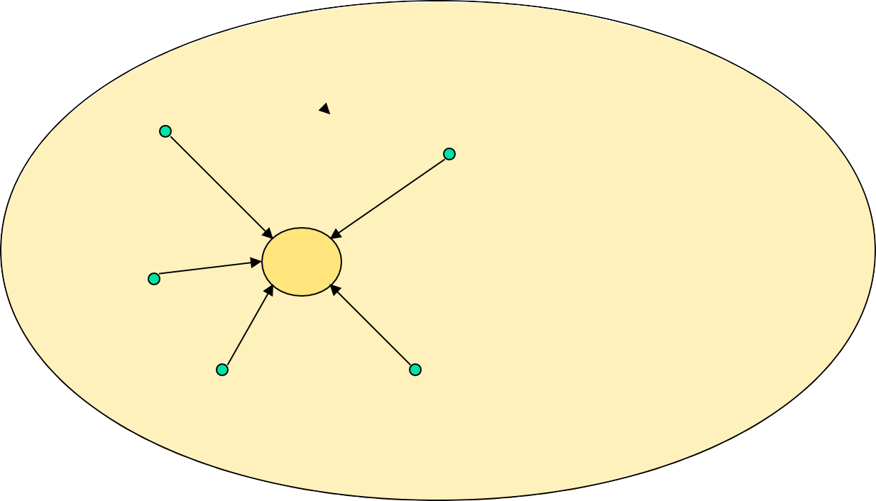
NP-Complete Problems
NP
problems
NP Complete problem

Slide 16
NP-Hard Problems
A problem Q is NP-hard if every problem K in NP is reducible to Q.
A problem Q is NP-Complete if it is in NP and is NP-hard.
The problems that cannot be solved by any algorithms are called Undecidable Problems.

Slide 17
Traveling Salesperson Problem
The salesperson wants to minimize the total traveling cost (time or distance) required to visit all the cities in a territory and return to the starting point.
This problem is known as traveling salesperson problem (TSP) or minimum tour problem.

Slide 18
Traveling Salesperson Problem
The Nearest-Neighbor Strategy:
nearestTSP(V,E,W) select an arbitrary vertex s to start the cycle C v=s; While there are vertices not yet in C select an edge vw of minimum weight, where w is not in C Add edge vw to C v=w; Add the edge vs to C return C;

Slide 19
Traveling Salesperson Problem
₁ 20 ₂
15
35
10
25
4
3
12
Starting at vertex 1, the algorithm gives the cycle 1, 3, 2, 4, 1 with total weight 85.

Slide 20
Traveling Salesperson Problem
The Shortest-Link Strategy:
ShortestLinkTSP(V,E,W) R=E; // R is remaining edges
C = Ø; // C is cycle edges
While R is not empty
Remove the lightest edge, vw, from R
if vw does not make a cycle with edges in C and vw would not be the third edge in C incident on v or w;
Add vw to C
Add the edge connecting the endpoints of the path in C return C;

Slide 21
Traveling Salesperson Problem
₁ 20 ₂
15
35
10
25
4
3
12
The algorithm selects the edges:
(2, 3), (3, 4), (1, 2), (1, 4)
Weight = 77

Slide 22
Thank You

